Slide 1


Bacterial cell structure
Lecture 4
Prof. Dr. Munira Ch. Ismaeel
Ass. Prof. Dr. Israa AJ Ibrahim

Slide 2
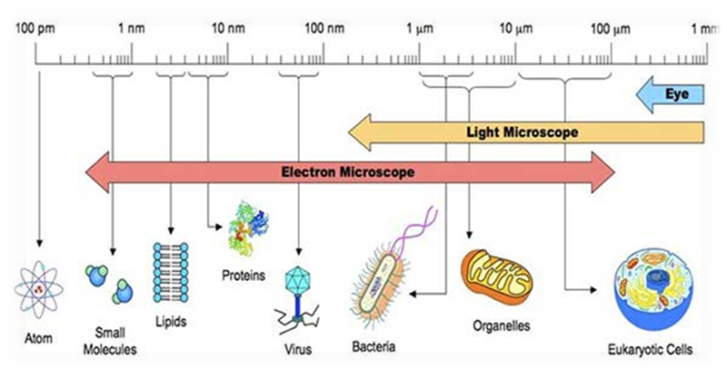
Bacterial cell structure Lec. 4
Prof. Dr. Munira Ch. Ismaeel and Ass. Prof. Dr. Israa AJ Ibrahim

Slide 3
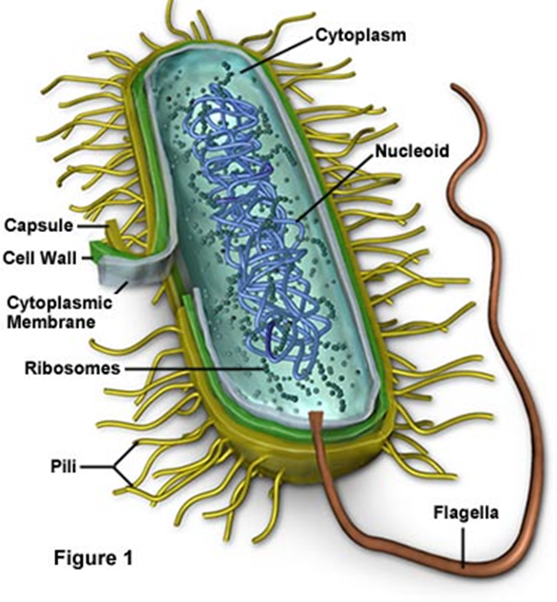
Bacterial cell structure
Bacteria are prokaryotes, lacking well-defined nuclei and membrane-bound organelles, and with chromosomes composed of a single closed DNA circle. They come in many shapes and sizes.

Slide 4
Bacterial cell structure
They are as unrelated to human beings as living things can be, but bacteria are essential to human life and life on planet Earth. Although they are notorious for their role in causing human diseases, from tooth decay to the Black Plague.
In the other hand, there are beneficial species that are essential to good health: For example,
-One species that lives symbiotically in the large intestine manufactures vitamin K, an essential blood clotting factor.
-Bacteria give yogurt its tangy flavor and sourdough breads its sour taste.
-They make it possible for ruminant animals (cows, sheep, goats(to digest plant cellulose and for some plants, (soybean, peas, alfalfa) to convert nitrogen to a more usable form.

Slide 5
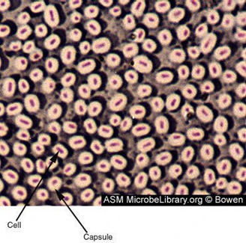
Bacterial cell structure-Capsule
Some species of bacteria have a third protective covering, a capsule made up of polysaccharides (complex carbohydrates). Capsules play a number of roles, but the most important are to keep the bacterium from drying out and to protect it from phagocytosis (engulfing) by larger microorganisms. The capsule is a major virulence factor in the major disease-causing bacteria, such as Streptococcus pneumoniae

Slide 6
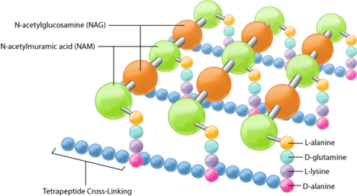
Bacterial cell structure- Cell Wall
Each bacterium is enclosed by a rigid cell wall composed of peptidoglycan, a protein-sugar (polysaccharide) molecule. The function of cell wall is:
1- The wall gives the cell its shape.
2- Surrounds the cytoplasmic membrane.
3- Protecting it from the environment.
4- It also helps to anchor appendages like the pili and flagella, which originate in the cytoplasm membrane and protrude through the wall to the outside.

Slide 7
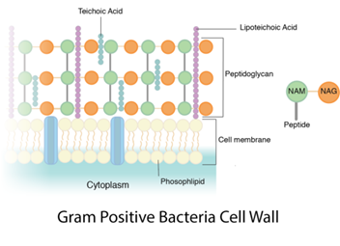
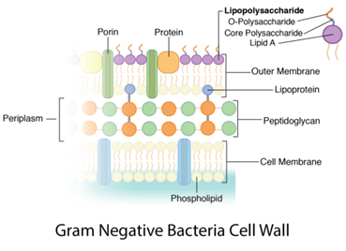
Bacterial cell structure-Cell Wall
Cell wall composition varies widely amongst bacteria and is one of the most important factors in bacterial species analysis and differentiation. A technique devised by Danish physician Hans Christian Gram in 1884, uses a staining and washing technique to differentiate between the two forms (gram positive bacteria and gram negative bacteria).

Slide 8
Bacterial cell structure- Cytoplasm
The cytoplasm, or protoplasm, of bacterial cells is where the functions for cell growth, metabolism, and replication are carried out. It is a gel-like matrix composed of water, enzymes, nutrients, wastes, and gases and contains cell structures such as ribosomes, a chromosome, and plasmids.

Slide 9
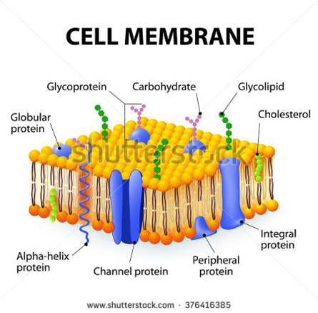
Bacterial cell structure- Cytoplasmic Membrane
A layer of phospholipids and proteins, called the cytoplasmic membrane, encloses the interior of the bacterium, regulating the flow of materials in and out of the cell. This is a structural trait bacteria share with all other living cells; a barrier that allows them to selectively interact with their environment. Membranes are highly organized and asymmetric having two sides, each side with a different surface and different functions.

Slide 10
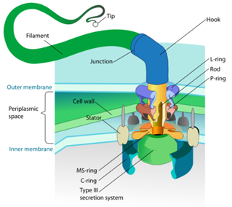
Bacterial cell structure- Flagella
Flagella (singular, flagellum) are hair like structures that provide a means of locomotion for those bacteria that have them. They can be found at either or both ends of a bacterium or all over its surface. The flagella beat in a propeller-like motion to help the bacterium move toward nutrients; away from toxic chemicals; or, in the case of the photosynthetic cyanobacteria; toward the light.

Slide 11
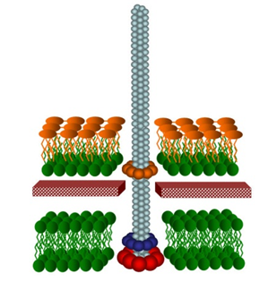
Bacterial cell structure- Pili
Many species of bacteria have pili (singular, pilus), small hairlike projections emerging from the outside cell surface. These outgrowths assist the bacteria in attaching to other cells and surfaces, such as teeth, intestines, and rocks. Specialized pili are used for conjugation, during which two bacteria exchange fragments of plasmid DNA.

Slide 12
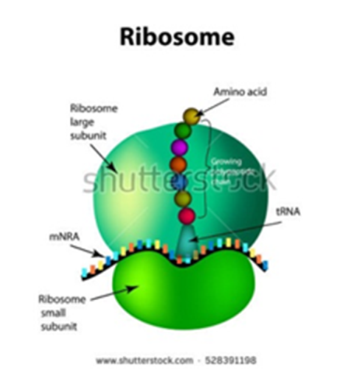
Bacterial cell structure-Ribosomes
Ribosomes are microscopic "factories" found in all cells, including bacteria. They translate the genetic code from the molecular language of nucleic acid to that of amino acids—the building blocks of proteins.
-Ribosomes consist of two major components: the small ribosomal subunit, which reads the RNA, and the large subunit, which joins amino acids to form a polypeptide chain. Each subunit is composed of one or more ribosomal RNA (rRNA) molecules and a variety of ribosomal proteins (r-protein or rProtein.)
-Prokaryotes have 70S ribosomes, each consisting of a small (30S) and a large (50S) subunit,{ their small subunit has a 16S RNA subunit (consisting of 1540 nucleotides) bound to 21 proteins. The large subunit is composed of a 5S RNA subunit (120 nucleotides), a 23S RNA subunit (2900 nucleotides) and 31 proteins}.

